Slide 1
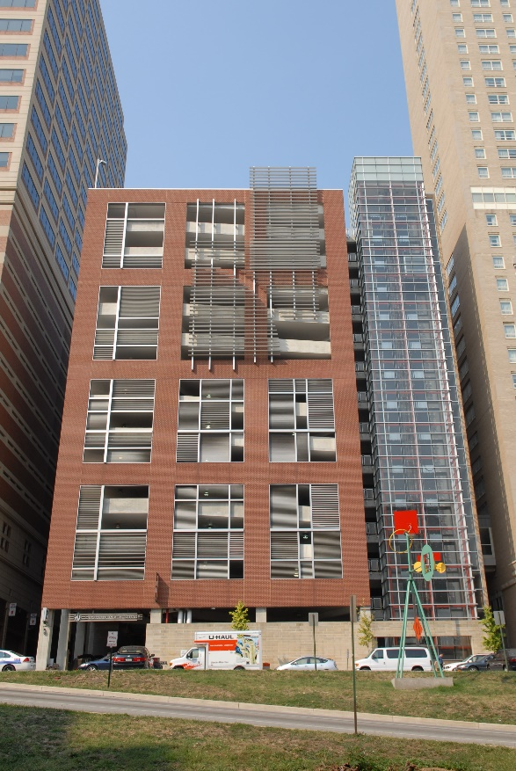
Board of Directors Meeting
April 11, 2023
Via Videoconference
4:00 pm – 5:00 pm

Slide 2
PABC Board of Directors Meeting Agenda April 11, 2023
Board Approvals
Board Meeting Minutes of March 14, 2023
Off-Street Parking (David Morgan)
Review of Metrics
Projects and Updates
New Business - None
Capital Projects (Na’Jah Jackson)
Projects and Updates
New Business - None
On-Street Parking
Residential Permit Parking / Permits (Shamir Cole-Butler)
Review of Metrics
Financials
Projects and Updates
New Business
Rate Adjustment Recommendations – Baltimore Street, Fleet & Eden, and Caroline Street Garages
Parking Meters (Norman Chase)
Review of Metrics
Financials
Projects and Updates
New Business - None
Residential Reserved Disabled Parking (Michelle Thompson)
Review of Metrics
Projects and Updates
New Business - None
Valet Regulations (Andre Poole)
Review of Metrics
Financials
Projects and Updates
New Business - None
Parking Planning (Fran Burnszynski)
Review of Metrics
Projects and Updates
New Business - None
Electric Vehicle Charging (Tim von Stetten)
Projects and Updates
New Business - None
Administration (Pete Little)
Review of Metrics
Financials
Projects and Updates
New Business
IRS 401K Plan Random Audit
Parking Planner III Position Approval

