Slide 1
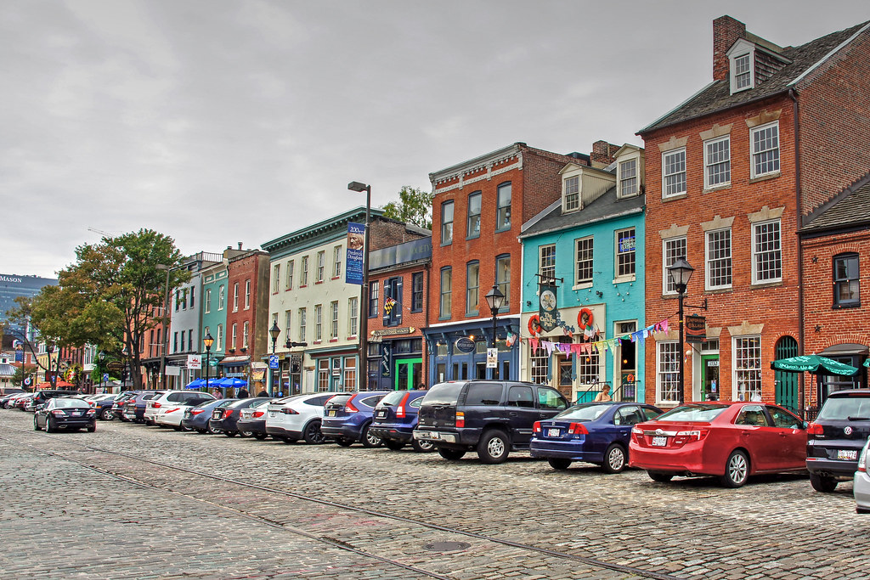
Board of Directors Meeting
July 11, 2023
Via Videoconference
4:00 pm – 5:00 pm

Slide 2
PABC Board of Directors Meeting Agenda July 11, 2023
Board Approvals
Board Meeting Minutes of June 13, 2023
Off-Street Parking (David Morgan)
Review of Metrics
Projects and Updates
New Business - None
Capital Projects (Na’Jah Jackson)
Projects and Updates
New Business
Little Italy Garage Elevator Heat Detectors Expense Approval
Caroline Street Garage Elevator Smoke Detectors Expense Approval
Fleet & Eden Garage Elevator Waterproofing Expense Approval
On-Street Parking
Residential Permit Parking / Permits (Shamir Cole-Butler)
Review of Metrics
Financials
Projects and Updates
New Business - None
Parking Meters (Norman Chase)
Review of Metrics
Financials
Projects and Updates
New Business - None
Residential Reserved Disabled Parking (Michelle Thompson)
Review of Metrics
Projects and Updates
New Business - None
Valet Regulations (Andre Poole)
Review of Metrics
Financials
Projects and Updates
New Business - None
Parking Planning (Fran Burnszynski)
Review of Metrics
Projects and Updates
New Business
Fells Point Demand Based Parking Meter Rate Recommendations
Electric Vehicle Charging (Tim von Stetten)
Projects and Updates
New Business - None
Administration (Pete Little)
Review of Metrics
Financials
Projects and Updates
New Business
PABC Annual Audit Expense Approval
Executive Director’s Contract

