Slide 1
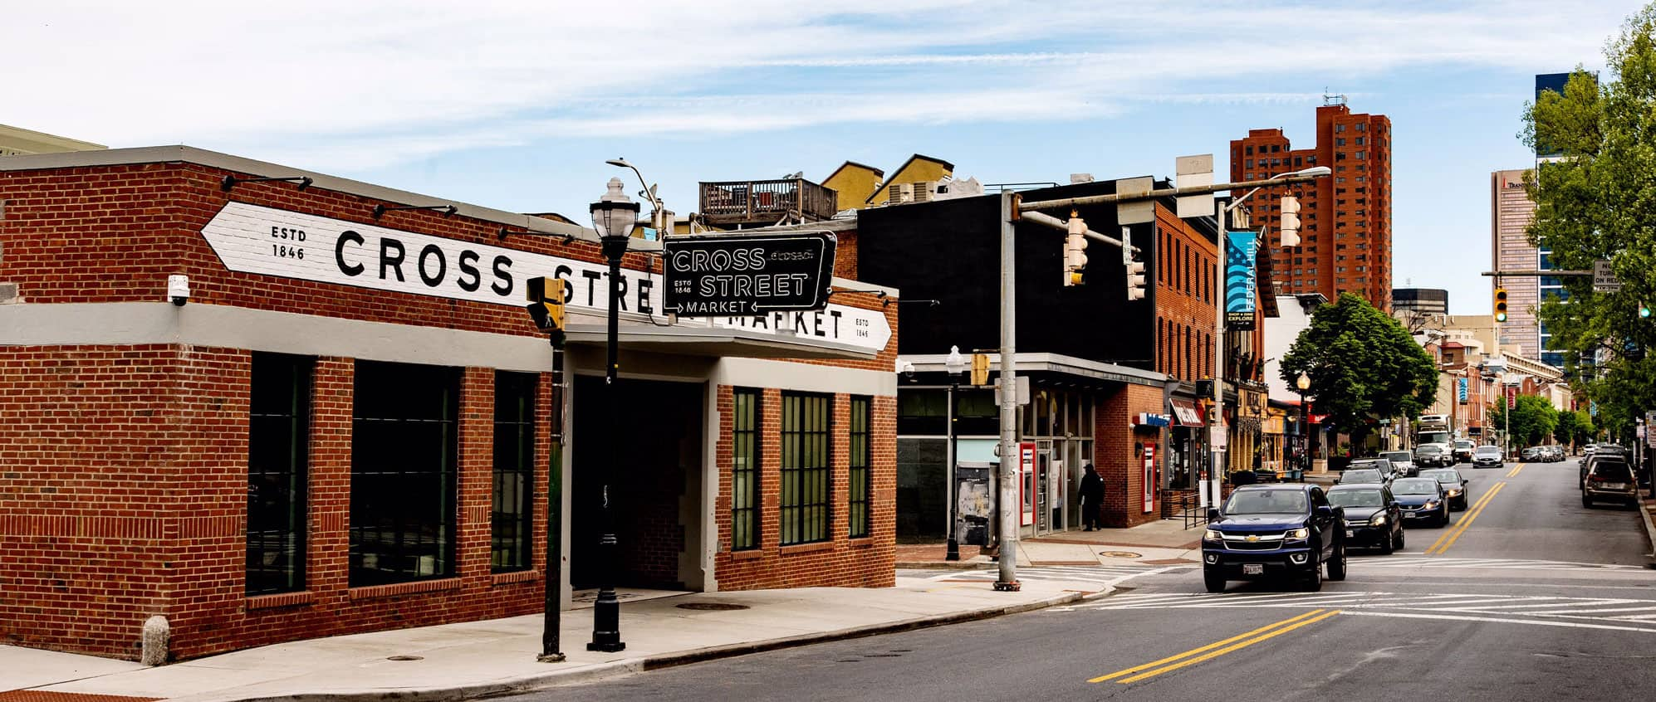
Board of Directors Meeting
June 13, 2023
Via Videoconference
4:00 pm – 5:00 pm

Slide 2
PABC Board of Directors Meeting Agenda June 13, 2023
Board Approvals
Board Meeting Minutes of May 9, 2023
Off-Street Parking (David Morgan)
Review of Metrics
Projects and Updates
New Business
Penn Station Drain Cleaning Recommendation
Capital Projects (Na’Jah Jackson)
Projects and Updates
New Business - None
On-Street Parking
Residential Permit Parking / Permits (Shamir Cole-Butler)
Review of Metrics
Financials
Projects and Updates
New Business - None
Parking Meters (Norman Chase)
Review of Metrics
Financials
Projects and Updates
New Business - None
Residential Reserved Disabled Parking (Michelle Thompson)
Review of Metrics
Projects and Updates
New Business - None
Valet Regulations (Andre Poole)
Review of Metrics
Financials
Projects and Updates
New Business
South Baltimore Demand Based Parking Meter Rate Recommendations
Parking Planning (Fran Burnszynski)
Review of Metrics
Projects and Updates
New Business - None
Electric Vehicle Charging (Tim von Stetten)
Projects and Updates
New Business - None
Administration (Pete Little)
Review of Metrics
Financials
Projects and Updates
New Business
Compensation Study Report and Recommendations
FY 2024 Administrative Grant Budget Approval
Purchase of New Switches Expense Approval
Barracuda Backup Subscription Renewal Expense Approval

