Slide 1
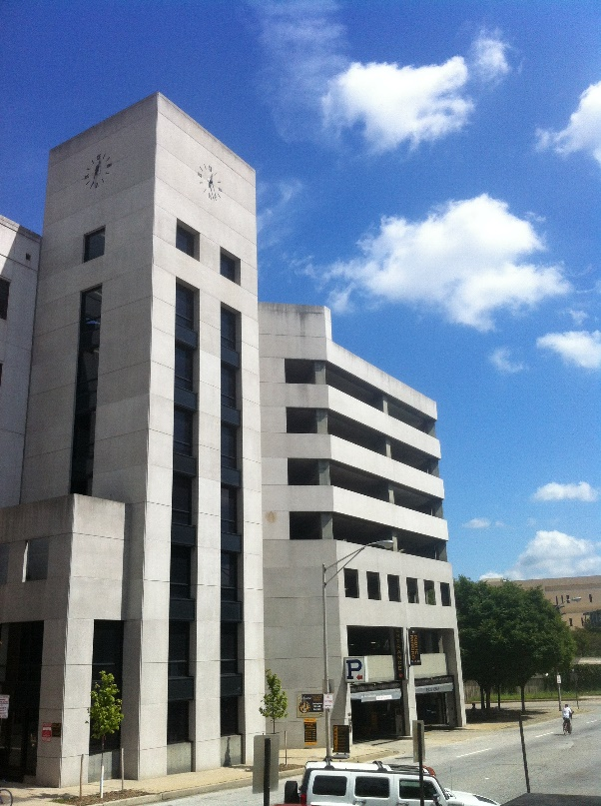
Board of Directors Meeting
June 11, 2024
Via Videoconference
4:00 pm – 5:00 pm

Slide 2
PABC Board of Directors Meeting Agenda June 11, 2024
Board Approvals
Board Meeting Minutes of May 14, 2024
Off-Street Parking (David Morgan)
Review of Metrics
Projects and Updates
New Business - None
Capital Projects (Na’Jah Jackson)
Projects and Updates
New Business
Lexington Street Garage Overhead Door Replacement Expense Approval
On-Street Parking
Residential Permit Parking / Permits (Shamir Cole-Butler)
Review of Metrics
Financials
Projects and Updates
New Business
VPP Enforcement Pilot Program Vehicle Acquisition Expense Approval Request
Parking Meters (Norman Chase)
Review of Metrics
Financials
Projects and Updates
New Business - None
Residential Reserved Disabled Parking (Michelle Thompson)
Review of Metrics
Projects and Updates
New Business - None
Valet Regulations (Andre Poole)
Review of Metrics
Financials
Projects and Updates
New Business - None
Parking Planning (Fran Burnszynski)
Review of Metrics
Projects and Updates
New Business
Central Business District Demand-Based Parking Meter Rate Setting Recommendation
Electric Vehicle Charging (Tim von Stetten)
Review of Metrics
Projects and Updates
New Business - None
Administration (Pete Little)
Review of Metrics
Financials
Projects and Updates
New Business
Annual Auditor Recommendation
FY 2025 Administrative Budget Recommendation

