Slide 1
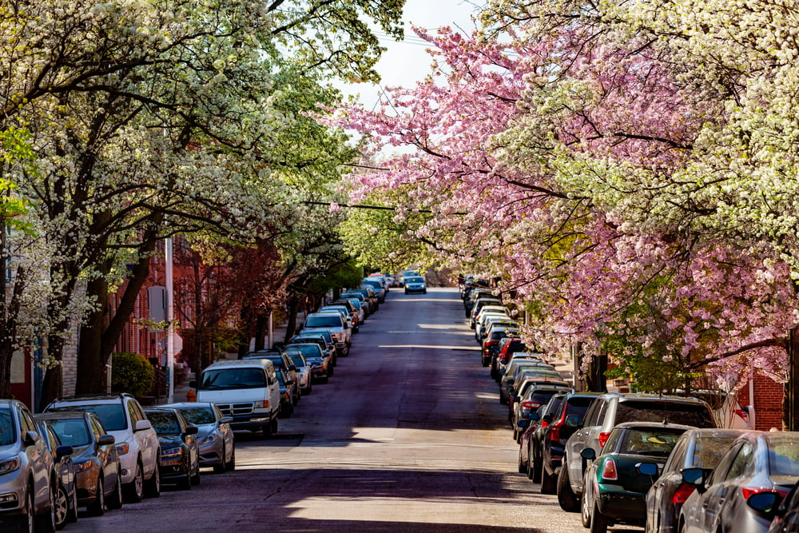
Board of Directors Meeting
March 12, 2024
Via Videoconference
4:00 pm – 5:00 pm

Slide 2
PABC Board of Directors Meeting Agenda March 12, 2024
Board Approvals
Board Meeting Minutes of January 9, 2024
Off-Street Parking (David Morgan)
Review of Metrics
Projects and Updates
New Business
New PARCS Performance and Payment Bonds Expense Approval
Capital Projects (Na’Jah Jackson)
Projects and Updates
New Business
Lexington Street Garage Overhead Door Replacement Expense Approval
On-Street Parking
Residential Permit Parking / Permits (Shamir Cole-Butler)
Review of Metrics
Financials
Projects and Updates
New Business - None
Parking Meters (Norman Chase)
Review of Metrics
Financials
Projects and Updates
New Business
Mobile Parking Payment and Text to Pay Parking Provider Recommendations
Residential Reserved Disabled Parking (Michelle Thompson)
Review of Metrics
Projects and Updates
New Business - None
Valet Regulations (Andre Poole)
Review of Metrics
Financials
Projects and Updates
New Business - None
Parking Planning (Fran Burnszynski)
Review of Metrics
Projects and Updates
New Business
Federal Hill Demand Based Parking Meter Rate Recommendations
Electric Vehicle Charging (Tim von Stetten)
Review of Metrics
Projects and Updates
New Business - None
Administration (Pete Little)
Review of Metrics
Financials
Projects and Updates
New Business
Cobblestone Agreement Expense Approval
PABC Procurement Policy Revisions Recommendations

