Slide 1
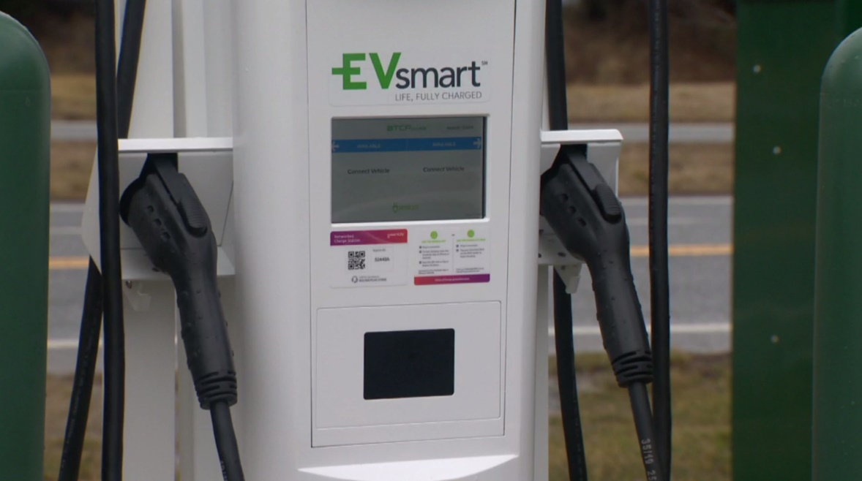
Board of Directors Meeting
May 10, 2022
Via Videoconference
4:00 pm – 5:00 pm

Slide 2
PABC Board of Directors Meeting Agenda May 10, 2022
Board Approvals
Board Meeting Minutes of April 12, 2022
Off-Street Parking (David Morgan)
Review of Metrics
Projects and Updates
New Business
Baltimore Street Garage Elevator #2 Drive Replacement Expense Approval
Capital Projects (Na’Jah Jackson)
Projects and Updates
New Business - None
On-Street Parking
Residential Permit Parking / Permits (Shamir Cole)
Review of Metrics
Financials
Projects and Updates
New Business - None
Parking Meters (Tonya Basilio)
Review of Metrics
Financials
Projects and Updates
New Business - None
Residential Reserved Disabled Parking (Michelle Thompson)
Review of Metrics
Projects and Updates
New Business - None
Valet Regulations (Quiera Bryant)
Review of Metrics
Financials
Projects and Updates
New Business - None
Parking Planning (Fran Burnszynski)
Review of Metrics
Projects and Updates
New Business - None
Administration (Pete Little)
Review of Metrics
Financials
Projects and Updates
New Business
Barracuda Backup Software Expense Approval
Electric Vehicle Charging Stations Grant Proposals Matching Funds Expense Approval
Electric Vehicle Charging Programs Manager Position
FY2023 Administrative Budget

