Slide 1
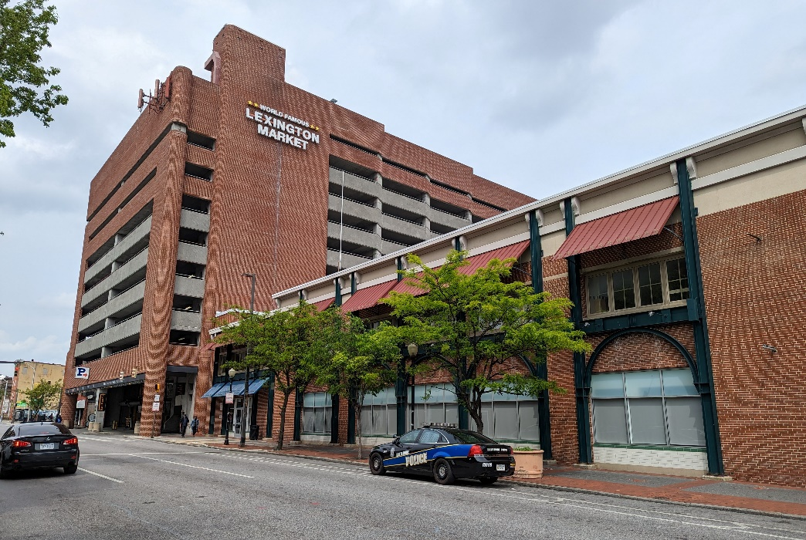
Board of Directors Meeting
May 9, 2023
Via Videoconference
4:00 pm – 5:00 pm

Slide 2
PABC Board of Directors Meeting Agenda May 9, 2023
Board Approvals
Board Meeting Minutes of April 11, 2023
Off-Street Parking (David Morgan)
Review of Metrics
Projects and Updates
New Business - None
Capital Projects (Na’Jah Jackson)
Projects and Updates
New Business - None
On-Street Parking
Residential Permit Parking / Permits (Shamir Cole-Butler)
Review of Metrics
Financials
Projects and Updates
New Business
Virtual Permit Parking (VPP) System RFP Respondents and Cost Proposals
Parking Meters (Norman Chase)
Review of Metrics
Financials
Projects and Updates
New Business - None
Residential Reserved Disabled Parking (Michelle Thompson)
Review of Metrics
Projects and Updates
New Business - None
Valet Regulations (Andre Poole)
Review of Metrics
Financials
Projects and Updates
New Business - None
Parking Planning (Fran Burnszynski)
Review of Metrics
Projects and Updates
New Business - None
Electric Vehicle Charging (Tim von Stetten)
Projects and Updates
New Business - None
Administration (Pete Little)
Review of Metrics
Financials
Projects and Updates
New Business
Phone System Contract Recommendation
New Office Servers Recommendation
Computer Equipment Expense Approval

