Slide 1
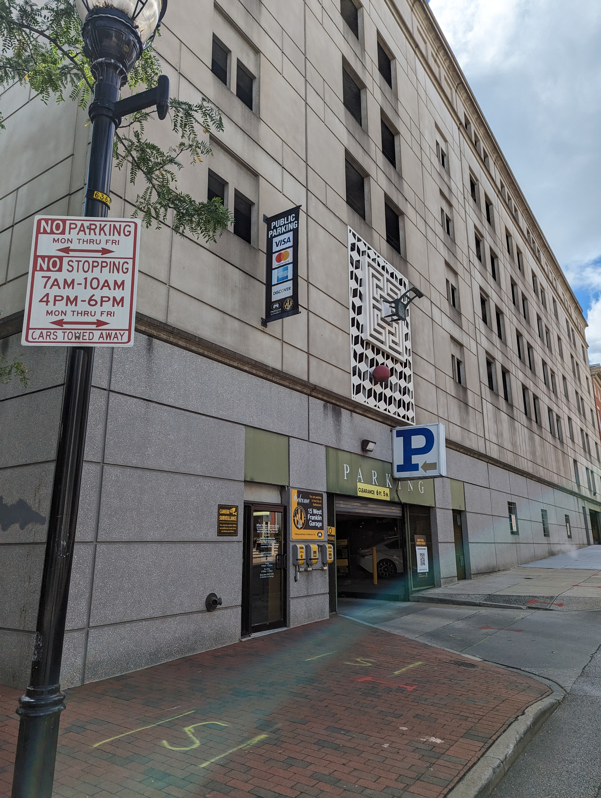
Board of Directors Meeting
November 14, 2023
Via Videoconference
4:00 pm – 5:00 pm

Slide 2
PABC Board of Directors Meeting Agenda November 14, 2023
Board Approvals
Board Meeting Minutes of September 12, 2023
FY2023 PABC Annual Audit – Ellin & Tucker (Sandra Downs)
Off-Street Parking (David Morgan)
Review of Metrics
Projects and Updates
New Business
Marina Garage Electrical Repairs Expense Approval
Marina Garage Electrical Repairs Additional Expense Approval
Capital Projects (Na’Jah Jackson)
Projects and Updates
New Business
Penn Station Garage Structural Assessment Expense Approval
Little Italy Garage Structural Assessment Expense Approval
Franklin Street Garage Structural Assessment Expense Approval
Market Center Garage Renovation Additional Expense Approval
On-Street Parking
Residential Permit Parking / Permits (Shamir Cole-Butler)
Review of Metrics
Financials
Projects and Updates
New Business
RPP/VPP Permit Management System Recommendation
Parking Meters (Norman Chase)
Review of Metrics
Financials
Projects and Updates
New Business - None
Residential Reserved Disabled Parking (Michelle Thompson)
Review of Metrics
Projects and Updates
New Business - None
Valet Regulations (Andre Poole)
Review of Metrics
Financials
Projects and Updates
New Business - None
Parking Planning (Fran Burnszynski)
Review of Metrics
Projects and Updates
New Business
Mount Vernon Demand-Based Parking Meter Rate Setting Recommendations
Electric Vehicle Charging (Tim von Stetten)
Projects and Updates
New Business - None
Administration (Pete Little)
Review of Metrics
Financials
Projects and Updates
New Business - None

