Slide 1
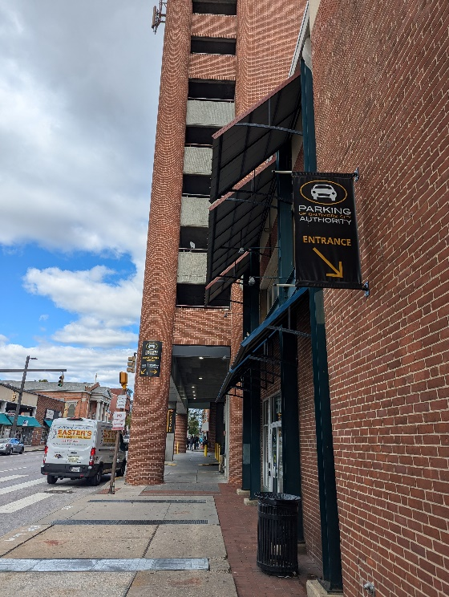
Board of Directors Meeting
November 12, 2024
Via Videoconference
4:00 pm – 5:00 pm

Slide 2
PABC Board of Directors Meeting Agenda October 8, 2024
Board Approvals
Board Meeting Minutes of October 8, 2024
FY2024 PABC Annual Audit – Ellin & Tucker (Sandra Downs)
Off-Street Parking (David Morgan)
Review of Metrics
Projects and Updates
New Business - None
Capital Projects (Na’Jah Jackson)
Projects and Updates
New Business - None
On-Street Parking
Residential Permit Parking / Permits (Shamir Cole-Butler)
Review of Metrics
Financials
Projects and Updates
New Business - None
Parking Meters (Norman Chase)
Review of Metrics
Financials
Projects and Updates
New Business - None
Residential Reserved Disabled Parking (Michelle Thompson)
Review of Metrics
Projects and Updates
New Business - None
Valet Regulations (Andre Poole)
Review of Metrics
Financials
Projects and Updates
New Business - None
Parking Planning (Fran Burnszynski)
Review of Metrics
Projects and Updates
New Business
Federal Hill Demand-Based Parking Meter Rate Setting Recommendations
Electric Vehicle Charging (Nicole Caesar)
Review of Metrics
Projects and Updates
New Business - None
Administration (Pete Little)
Review of Metrics
Financials
Projects and Updates
New Business
PABC Office Janitorial Services Recommendation (Lakeisha Payton)

