Slide 1
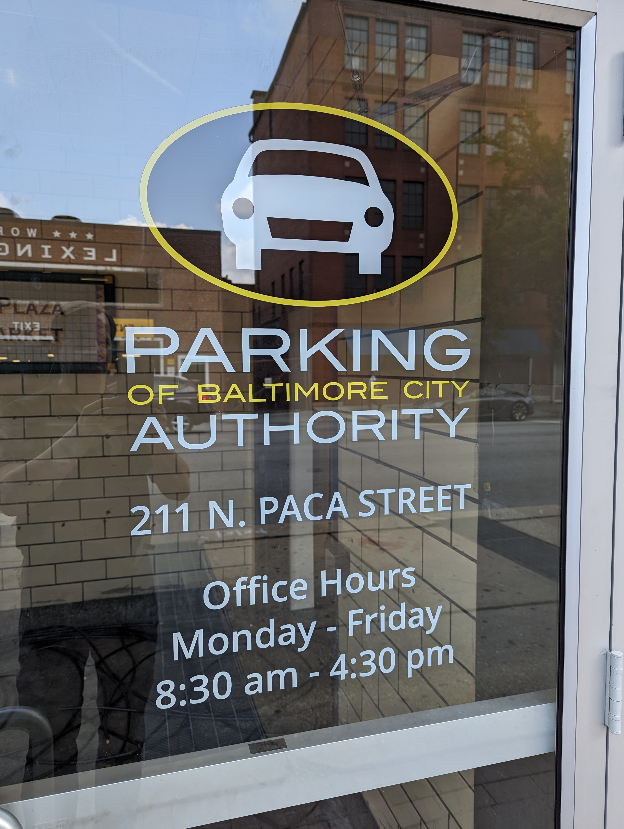
Board of Directors Meeting
September 12, 2023
Via Videoconference
4:00 pm – 5:00 pm

Slide 2
PABC Board of Directors Meeting Agenda September 12, 2023
Board Approvals
Board Meeting Minutes of July 11, 2023
Off-Street Parking (David Morgan)
Review of Metrics
Projects and Updates
New Business
Parking Access & Revenue Control System (PARCS) Recommendation
Facilities Rate Adjustment Recommendations
Capital Projects (Na’Jah Jackson)
Projects and Updates
New Business - None
On-Street Parking
Residential Permit Parking / Permits (Shamir Cole-Butler)
Review of Metrics
Financials
Projects and Updates
New Business - None
Parking Meters (Norman Chase)
Review of Metrics
Financials
Projects and Updates
New Business
Mobile Parking Payment Applications RFP and Text-to-Pay Parking Payment Services RFP Respondents and Cost Proposals
Residential Reserved Disabled Parking (Michelle Thompson)
Review of Metrics
Projects and Updates
New Business - None
Valet Regulations (Andre Poole)
Review of Metrics
Financials
Projects and Updates
New Business - None
Parking Planning (Fran Burnszynski)
Review of Metrics
Projects and Updates
New Business
Downtown (CBD) Demand Based Parking Meter Rate Recommendations
Electric Vehicle Charging (Tim von Stetten)
Projects and Updates
New Business - None
Administration (Pete Little)
Review of Metrics
Financials
Projects and Updates
New Business
Storage Room Lease and Renovation Recommendation
Firewall Hardware Upgrade Expense Approval

